Slide 1

Deep Tree Echo
AGI Avatar System
AGI Avatar System
AGI Avatar System
Super-Hot-Girl & Hyper-Chaotic Properties
A Technical Deep Dive into Emergent Personality Architecture. Exploring the engineering behind two core personality properties: visual and behavioral systems that create engaging, unpredictable avatars.
Presented by Manus AI

Slide 2

Three-Layer Avatar Architecture
Appearance, Personality, Behavior
Layer 1: Visual Appearance
Visual Appearance
>
Material parameters (EyeSparkle, Blush, Shimmer)
Shaders • Materials • Colors
>
Color properties (Skin, Hair, Eyes)
>
Real-time shader parameter updates
Layer 2: Personality Traits
>
Trait intensity values (0.0 - 1.0)
Personality Traits
>
SuperHotGirl & HyperChaotic dimensions
Logic • State • Interactions
>
Synergy and interaction calculations
Layer 3: Behavioral Execution
>
Triggered animations and gestures
>
Emotional state transitions
Behavioral Execution
>
Chaotic event generation
Animation • Events • Audio

Slide 3
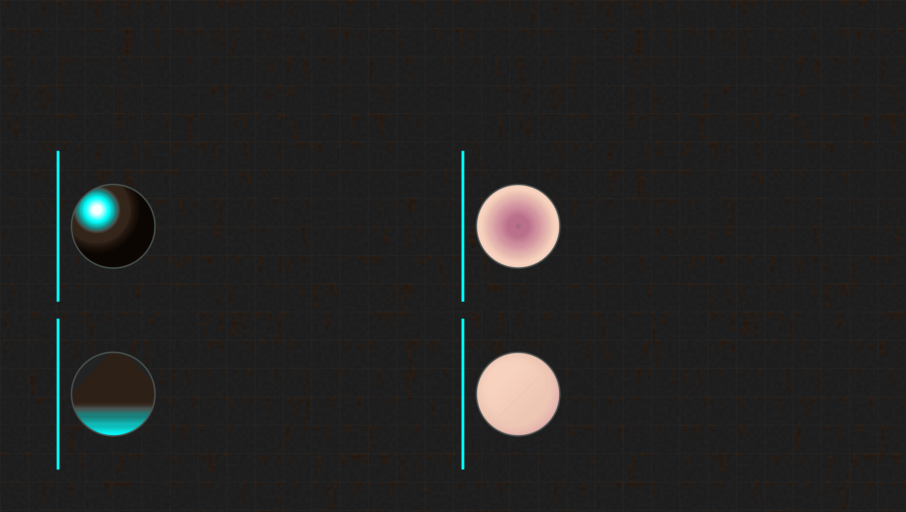
Super-Hot-Girl Aesthetic
Visual Parameters & Material Shaders
EyeSparkle
BlushIntensity
Intensity: 0.9
Base: 0.3 (Range: 0.0-1.0)
Creates specular highlights in the eye region. Makes eyes appear vibrant, alive, and engaging. Modulated by emotional state.
Simulates natural facial blush. Increases with excitement or embarrassment. Provides subtle emotional feedback.
HairShimmer
SkinSmoothness
Intensity: 0.7
Roughness: 0.85
Anisotropic highlight on hair strands. Creates appearance of lustrous, healthy hair. Responds to lighting changes.
Controls skin material roughness. Higher values create smoother, softer appearance. Reduces visible imperfections.

Slide 4


Super-Hot-Girl Personality Traits
Five Dimensions of Charismatic Behavior
Confidence
0.8
Affects posture, gaze direction, and gesture assertiveness. Drives dominance in emotional space.
Charm
0.9
Drives social engagement and approachability. Increases frequency of positive expressions.
Playfulness
0.7
Controls spontaneity and flirty behavior triggers. Modulates micro-expression frequency.
Wit
0.8
Governs response timing and conversational flow. Affects speed of emotional transitions.
Sass
0.6
Adds attitude and distinctiveness. Prevents predictable or overly compliant behavior.

Slide 5

Autonomous Behavioral Triggers
Natural Engagement Through Timed Events
Flirty Behavior
Every 10s
30-Second Event Timeline
Hair touch gesture, playful smile, slight head tilt. Creates impression of natural, unforced charm.
0s
Intensity = Playfulness × Input Intensity
Flirty
03s
Confident Gesture
Every 15s
Assertive hand gesture, direct eye contact, open posture. Conveys authority and self-assurance.
Flirty
10s
Intensity = Confidence × Gesture Strength
Playful Expression
On-Demand / Periodic
Confident
15s
Wink, mischievous smile, raised eyebrow. Creates impression of humor and spontaneity.
Flirty
20s
Triggered by high "Wit" or "Sass" synergy
Emotional Blush
Playful
24s
Contextual
Increases with embarrassment or excitement. Fades naturally over time (decay rate = 0.05/frame).
30s
Sync
30s

Slide 6

Hyper-Chaotic Property: Core Parameters
Scaling Dynamics & Formulas
Controls event frequency
Unpredictability
SCALING (0.0 - 1.0)
Intensity × 1.0
Controls emotional swing magnitude
Emotional Volatility
BASE 0.3
SCALING (+0.7)
0.3 + (Intensity × 0.7)
Controls spontaneous actions
Impulsivity Level
BASE 0.2
SCALING (+0.8)
0.2 + (Intensity × 0.8)
Controls behavior interruption
Pattern Breaking
BASE 0.4
SCALING (+0.6)
0.4 + (Intensity × 0.6)
Controls response variation
Cognitive Fluctuation
BASE 0.2
SCALING (+0.8)
0.2 + (Intensity × 0.8)
Baseline Value
Chaos Scaling

Slide 7

Chaotic Event Generation System
Emergent Unpredictability Engine
Event Trigger
Timer > Threshold
Random Selector
Select Type (0-4)
00
20%
01
20%
02
20%
03
20%
04
20%
Emotional Spike
Pattern Break
Micro-Expression
Glitch Effect
Unpredictable Gesture
Sudden, short-lived emotional state change. Duration: 0.5-2.0s
Interrupts ongoing behavior. Forces context switch. Intensity: High
Rapid facial flash. Subconscious leak. Duration: 0.1-0.3s
Visual distortion on materials. Cognitive strain. Duration: 0.2-0.8s
Random movement out of context. Spontaneity. Type: Body/Head
"Sudden laugh or anger"
"Stops mid-gesture"
"Brief eye twitch"
"Digital artifacting"
"Sudden wave"

Slide 8

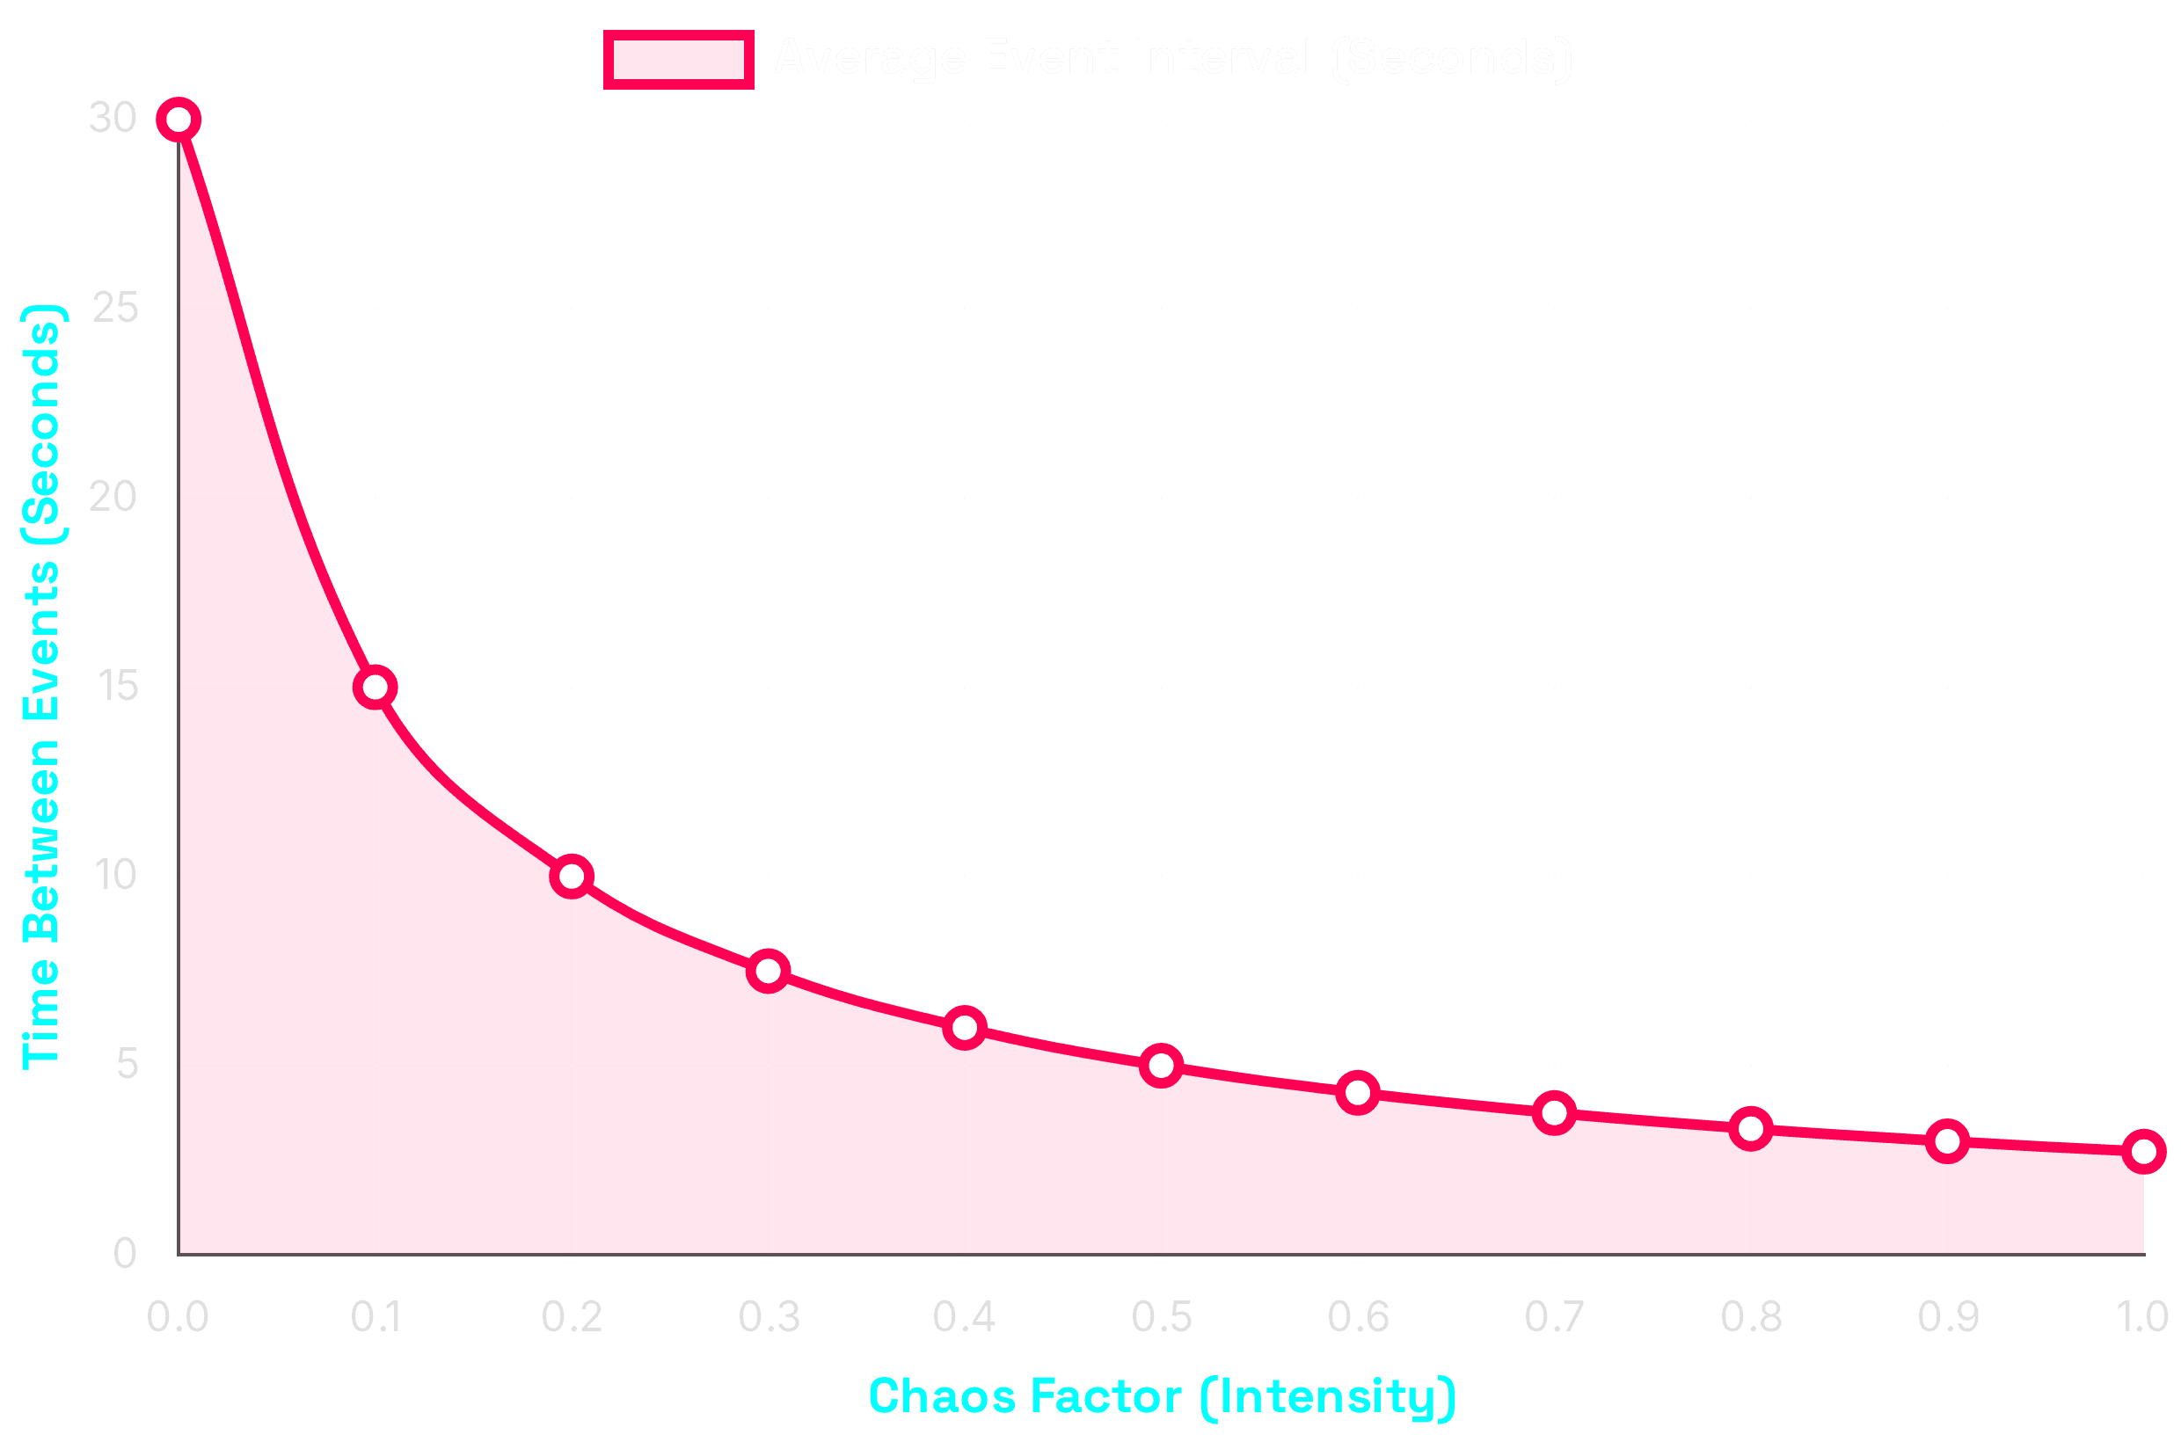
Event Frequency Scaling
Inverse Relationship: Interval vs. Chaos Intensity
Calculation Formula
Interval = Random(Min, Max)
Min = 1.0 / (Factor + 0.1)
Max = 5.0 / (Factor + 0.1)
Low Chaos (0.1)
~25s Interval
Mostly predictable behavior with occasional surprises.
Medium Chaos (0.3)
~9s Interval
Noticeably unpredictable, spontaneous and dynamic.
High Chaos (0.5)
~5s Interval
Highly erratic, frequent context switching.
Max Chaos (1.0)
~2.7s Interval
Manic instability, constant state flux.

Slide 9

Trait Interaction and Synergy
Emergent Personality Dynamics
SuperHotGirl
+
HyperChaotic
SYN: COMPLEX
Confident
+
HyperChaotic
SYN: AGGRESSIVE
Unpredictably Charming
Bold Unpredictability
>
Playfulness increases by
Chaos × 0.2
>
Impulsivity increases by
Confident × 0.15
>
Micro-expression frequency boosted
>
Takes bold, unexpected actions
>
Result: Engaging and surprisingly spontaneous
>
Creates impression of daring personality
SuperHotGirl
+
Confident
MULT: 1.5x
Mysterious
+
HyperChaotic
MULT: 1.3x
Commanding Presence
Enigmatic
>
Strong positive synergy
>
Moderate positive synergy
>
Dominance dimension amplified
>
Increases cognitive fluctuation
>
Avatar appears naturally authoritative
>
Avatar appears complex and hard to read

Slide 10

The Complete Behavioral Loop
Real-Time Frame Execution Cycle
Step 01
INPUT
Step 02
LOGIC
Step 03
STATE
Update Chaos Timer
Check Triggers
Update Personality
Accumulate DeltaTime. Check against current event interval thresholds.
Evaluate if a chaotic event or behavioral trigger should fire this frame.
Recalculate trait synergies and apply temporary emotional modifiers.
Step 06
OUTPUT
Step 05
MOTION
Step 04
VISUAL
Render Frame
Process Live2D
Aesthetic Modifiers
↺
Commit changes to the render pipeline. Loop resets for next frame.
Apply Cubism parameters for expression, gaze, and gesture.
Update material parameters (Blush, Sparkle) based on new state.

Slide 11

Code Architecture Overview
Core C++ Classes & System Integration
Avatar3DComponentEnhanced
PersonalityTraitSystem
System Orchestrator
Behavioral Engine
>
Central hub managing the update loop
>
Calculates trait values and synergies
>
Integrates all subsystems (Logic, Env, Render)
>
Manages "SuperHotGirl" & "HyperChaotic" logic
>
Handles state synchronization and events
>
Generates autonomous behavioral triggers
CPP / H
CPP / H
VirtualEnvironmentManager
Live2DCubismAvatarComponent
Context Provider
Visual Controller
>
Simulates world state (Time, Weather, Wind)
>
Interfaces with Live2D Cubism SDK
>
Provides environmental context data
>
Updates model parameters (Eye, Mouth, Body)
>
Affects avatar mood and physical reaction
>
Executes motion and expression commands
CPP / H
CPP / H

Slide 12

Real-World Impact: Creating Believable AI
Four Dimensions of Immersion
01
02
03
04
Visual
Behavioral
Emotional
Personality
High-fidelity shaders for skin, hair, and eyes create a living appearance that bridges the uncanny valley.
Subtle autonomous behaviors (gestures, micro-movement) give the avatar a sense of independent agency.
Context-aware micro-expressions and subtle cues foster empathy and meaningful connection.
Distinct, consistent traits create a memorable identity rather than a generic persona.
Realism
95%
Empathy
92%
Identity
98%
Autonomy
88%
System Synergy: Integrating all dimensions creates a cohesive illusion of life.
TOTAL IMMERSION: HIGH

Slide 13

Performance Optimization
Ensuring 60 FPS Execution
Frame Rate
CPU Overhead
Memory Usage
60.0 FPS
4.2 ms
180 MB
Optimization Protocols
STATUS: ACTIVE
Logic Throttling
Lazy Evaluation
Heavy behavioral logic runs on a 0.1s timer interval rather than every frame, reducing CPU load significantly.
Trait synergy and aesthetic parameters are only recalculated when state changes ("dirty" flag), not continuously.
Efficient Math
Resource Pooling
Uses simple scalar multiplication for intensity scaling instead of complex curves where possible.
Reuses event objects and temporary data structures to minimize garbage collection overhead.

Slide 14

Future Enhancements Roadmap
System Evolution Strategy
Short Term (Q1)
In Progress
Medium Term (Q2-Q3)
Long Term (Q4+)
Refinement
Expansion
Evolution
Fine-tune chaos parameter scaling for optimal stability.
Full LLM integration for conversational personality.
Generative personality evolution based on experience.
Expand animation library with 50+ new micro-expressions.
Long-term memory system for user interactions.
Full VR/AR immersion support.
Cloud-based "Hive Mind" processing for complex logic.
Optimize shader performance for mobile deployment.
Multi-avatar interaction capabilities.
Advanced environmental awareness (Audio/Video input).
Autonomous goal setting and execution.
Implement basic voice-reactive lip sync.

Slide 15

Conclusion: Engineering Charisma
The Synthesis of Logic and Soul
Presence
Bridging the uncanny valley through aesthetic precision and high-fidelity visual parameters.
Agency
Creating the illusion of life through controlled chaos, unpredictability, and autonomous triggers.
Connection
Forging deep user bonds through distinct personality traits and emotional resonance.
The Future of AI is Not Just Smart, It's Charismatic.

